Slide 1



Mentoring Program
Mentor Training
Praeliscere
Copyright Kathryn McClain

Slide 2

Agenda
Icebreaker
What is a Mentor?
Benefits of Mentorship
Mentoring Skills
Program Overview & Expectations
Mentee Intake Form

Slide 3


Icebreaker
Who was a mentor that was the most impactful to you?

Slide 4
What is a Mentor?

Slide 5


Benefits of Mentorship

Slide 6

Mentoring Skills
Empathy
Active Listening
Organization
Relationship Building
Leadership
Observation
Creativity
Ability to Provide Constructive Feedback
Conflict Management
Problem Solving
Self Management
Communication
Reference: Indeed Editorial Team. (2025, December 11). 12 Skills for Successful Mentors. Indeed. https://www.indeed.com/career-advice/career-development/mentorship-skills

Slide 7

Program Overview & Expectations
6 Month Mentorship Program Expectations
Meeting Topic Overview
Post Mentorship Program Expectations

Slide 8
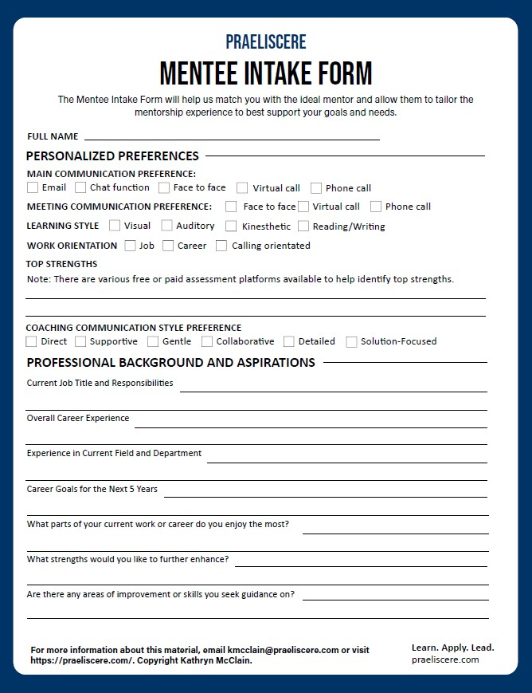
Mentee Intake Form

Slide 9
Mentee Intake Form

Slide 10
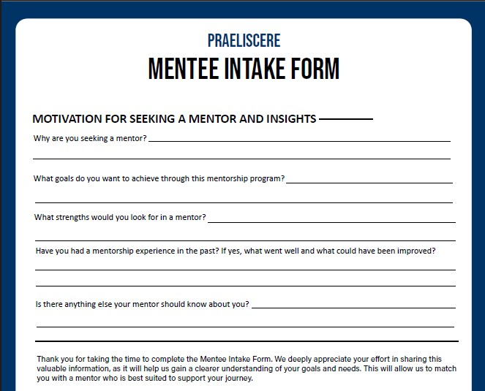
Mentee Intake Form

Slide 11
References
Indeed Editorial Team. (2025, December 11). 12 Skills for Successful Mentors. Indeed. https://www.indeed.com/career-advice/career-development/mentorship-skills

