Slide 1
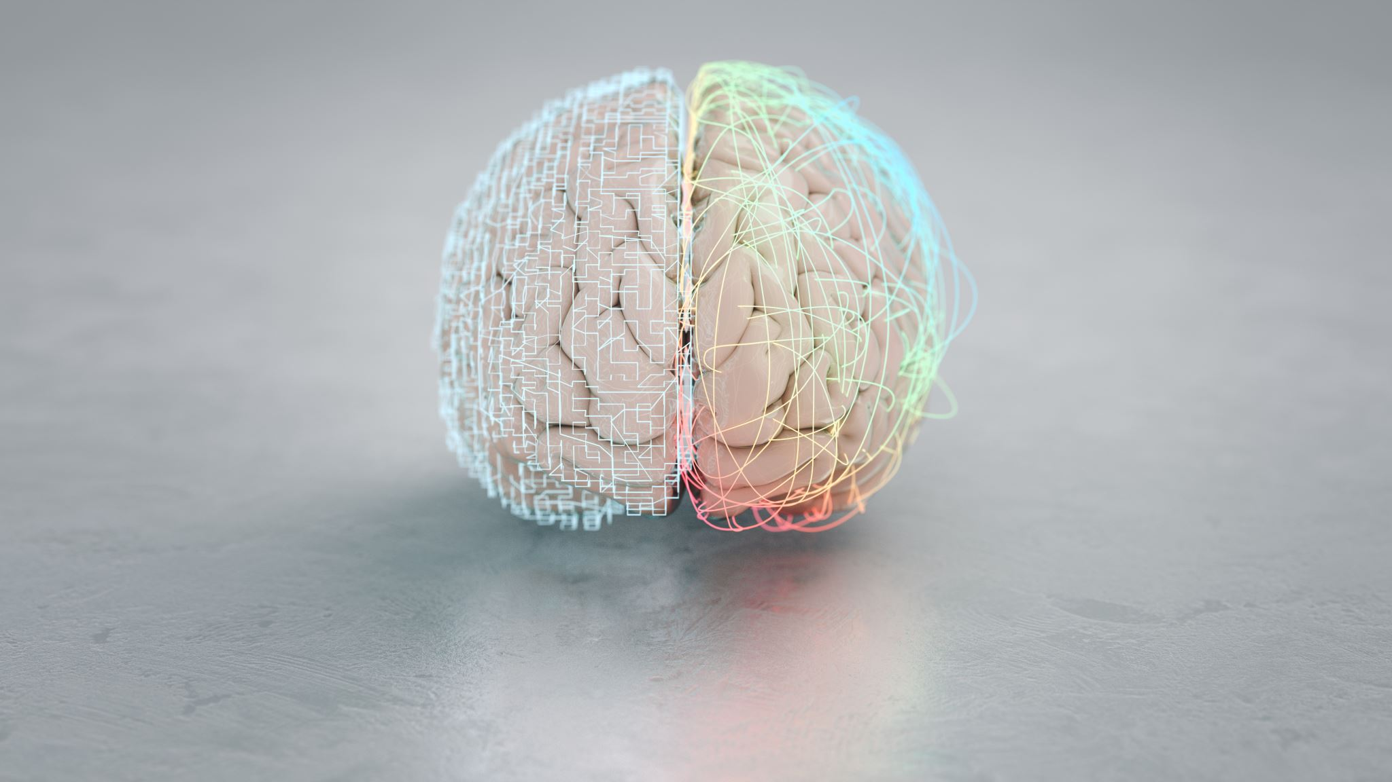
Emotional Intelligence
Praeliscere
Copyright Kathryn McClain

Slide 2
Agenda
What is Emotional Intelligence
Core Components
Assessments
Next Steps – Improving Your Emotional Intelligence
Discussion Questions

Slide 3

Emotional Intelligence
One's ability to manage and understand your emotions. Along with influence emotions and recognizing them from people you’re around (Landry, 2019)
You can develop and improve Emotional Intelligence
First created by Peter Salovey and John Mayer in 1990. A popular name associated with emotional intelligence is Daniel Goleman (Landry, 2019)

Slide 4
Emotional Intelligence
When looking at emotional intelligence vs. technical skills, 71% of employers put more value on emotional intelligence (Landry, 2019)
What is the strongest predictor of performance? It’s emotional intelligence (Landry, 2019)
Visionary leadership, emotional intelligence, and driving charge have shown in several studies a strong association (Goleman & Boyatzis, 2017)
Emotional Intelligence isn’t simply who is nice (Goleman, 2020)

Slide 5
Benefits of High and Consequences of Low Emotional Intelligence
Benefits of higher emotional intelligence (Landry, 2019):
Conflict resolved effectively
When under pressure stay calm
Improved employee engagement
Lower turnover rate
Interpersonal relationship management
Consequences of lower emotional intelligence (Indeed Employer Content Team, n.d.):
Lower/poor accountability, team dynamics, and productivity
Unproductive communication with management and employees
Rise in hiring costs and employee turnover

Slide 6

Core Components
Emotional Intelligence has many different models (Goleman & Boyatzis, 2017)
The typical breakdown of emotional intelligence involves four components (Landry, 2019):
  Self-awareness
  Self-management
  Social awareness
  Relationship management
Notes:
There are many different models of emotional intelligence
Depending on the source, there can be different models of emotional intelligence. Some of the options and potential correlations between them are:
Self-Awareness
Social Awareness/Empathy
Self-Management/Self-Regulation & Motivation
Relationship Management/Social Skills
The typical breakdown is though:
Self-awareness
Self-management
Social awareness
Relationship management

Slide 7

Self-Awareness
Is the core
Recognition of effects of your emotions on yourself and your team
Ability to understand weaknesses and strengths of yourself
Only 10-15% are actually self-aware BUT 95% of individuals think they are
Research has shown that coworkers that have low self-awareness can result in cutting success for the team in half (motivation lessens and stress increases)
(Landry, 2019)

Slide 8

Self-Management
Able to manage one's emotions
Even with obstacles able to maintain an outlook that is positive
Lack of self-management can be shown through less control of impulses
Better self-management is when you’re able to have more of a response vs. reaction
(Landry, 2019)

Slide 9

Social Awareness
Are you able to read the room? Social Awareness is when you’re able to identify others' emotions
Empathy is key
A study revealed those in leadership that become proficient in empathy result in 40% higher in engaging others, decision making, and coaching
Another study revealed those in leadership that are showing those they manage more empathy, are seen by their leadership as better performers
Improved social awareness increases effective communication and collaboration
(Landry, 2019)

Slide 10

Relationship Management
Ability to resolve conflict, coach, influence, and mentor other individuals
Handling conflict saves companies time and money. Research revealed conflict that isn’t handled can results in about 8 hours of company time
(Landry, 2019)

Slide 11
Harvard Business Review
Self-Awareness
Emotional self-awareness
Self-Management
Emotional self-control
Adaptability
Achievement orientation
Positive outlook
Social Awareness
Empathy
Organizational awareness
Relationship Management
Influence
Coach and Mentor
Conflict Management
Teamwork
Inspirational Leadership
Harvard Business Review identifies 4 domains: self-awareness, self-management, social awareness, and relationship management
There are competencies within each of these four domains
(Goleman & Boytzis, 2017)

Slide 12

Assessments
Free and Paid Online Assessments
Differences in Assessments
360-Degree Assessment
  Research has found that the level of discrepancy between how an individual rates themselves and how others rate them often indicates fewer strengths in emotional intelligence (Goleman & Boytzis, 2017)

Slide 13
Next Steps - Improving Your Emotional Intelligence
Self awareness is key
Ways to develop self awareness is (Landry, 2019):
Focus on your emotions
Continue your education related to emotional intelligence
Active listening
360-degree assessment
Journaling
Provide coaching

Slide 14

Discussion Questions
Think about someone who led you well. What was it in their emotional intelligence that stood out?
How do you think others view/experience your emotional intelligence?
When you have a stressful day, how does your emotional intelligence come out (positive and/or negative)?
What's one behavior you plan to practice daily?
What support from your colleagues can help?
How does improved/growing emotional intelligence look like on the team for you? What's one thing you'd like your team to adapt or maintain?

Slide 15
References
Goleman, D. & Boyatzis, R. (2017, February 6). Emotional intelligence has 12 elements, Which do you need to work on?. Harvard Business Review. https://hbr.org/2017/02/emotional-intelligence-has-12-elements-which-do-you-need-to-work-on
Goleman, D. (2020, December 22). What people (still) get wrong about emotional intelligence. Harvard Business Review. https://hbr.org/2020/12/what-people-still-get-wrong-about-emotional-intelligence
Landry, L. (2019, April 3). Why emotional intelligence is important in leadership. Harvard Business School Online. https://online.hbs.edu/blog/post/emotional-intelligence-in-leadership
Indeed Employer Content Team. (n.d.). The importance of emotional intelligence for employers and their teams. Indeed for employers. https://www.indeed.com/hire/c/info/benefits-of-emotional-intelligence?gad_source=1&gclid=CjwKCAiAlPu9BhAjEiwA5NDSA7I5DTGsKwFD4Q-4Xkgrr99CznHEC47uqAPB_nFmu1XVVWC71FIOZRoC9dAQAvD_BwE&aceid=&gclsrc=aw.ds

